Slide 1
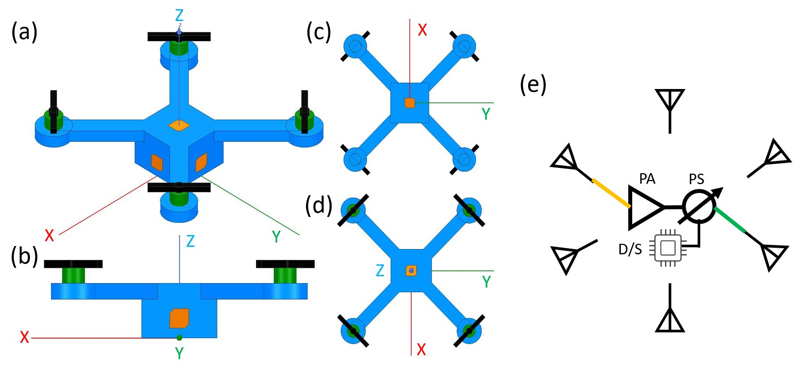
Spatial-Reconfigurable Phased Array
R09942006 Shih-Ming Huang

Slide 2
Outline
Introduction to Spatial-Reconfigurable Phased Array (SPRArray)
Application & Motivation
Multi-Tier Drone Architecture for 5G/B5G Cellular Networks: Challenges, Trends, and Prospects [5]
Survey on Previous Work
Radiation analysis of conformal phased array antennas on distorted structures (2003) [1]
A Self-Adapting Flexible (SELFLEX) Antenna Array for Changing Conformal Surface Applications (2013) [2]
A Survey on Indoor Positioning Systems (2014) [3]
Survey of Indoor Localization Systems and Technologies (2019) [4]
Self-Invented Microwave Assisted Positioning
Setup & Data Interpretation
Range Resolution: 2.3cm ; Max. Detection Range: 1.5m

Slide 3
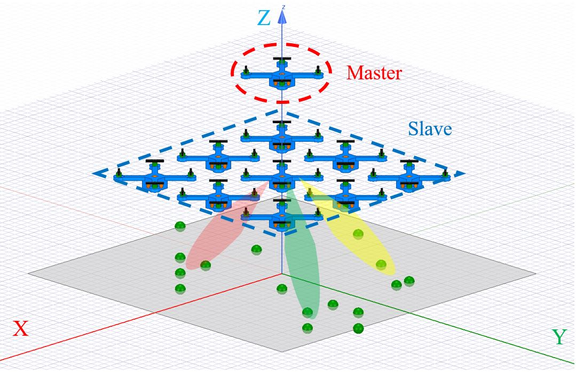
Introduction to Spatial-Reconfigurable Phased Array (SPRArray)
A SRPArray
A SPRCube
Circularly Polarized Antenna
Plastic Body

Slide 4
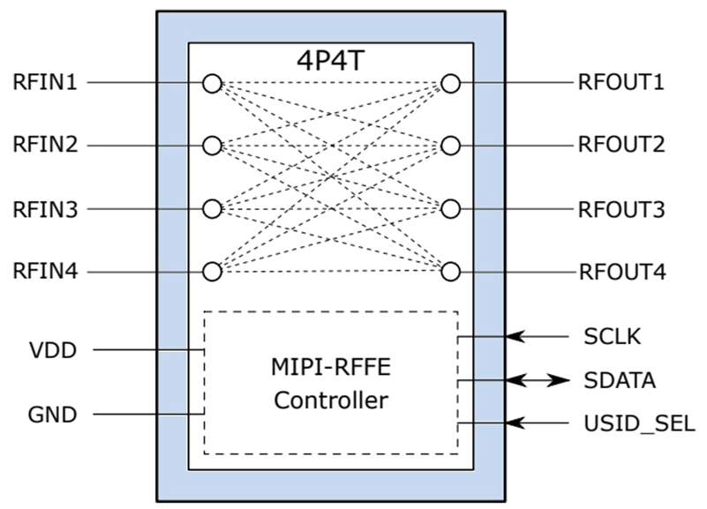
Implementation of SPRCube
Infineon
BGSX44MA12
Rx/Tx Antenna
6P6T RF Switch

Slide 5
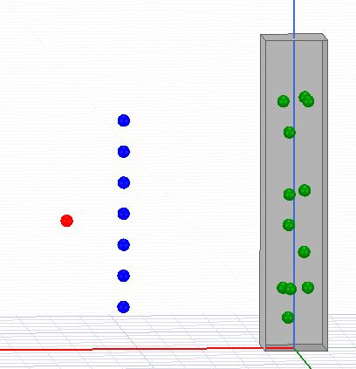
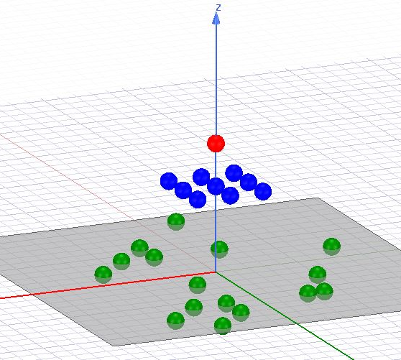
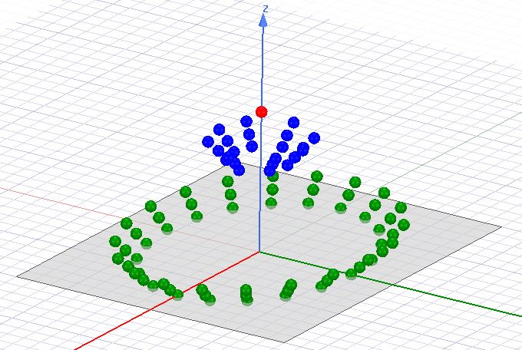
Application Scenario
(a)
(b)
(c)
Urban
Suburbs
Gym

Slide 6
Outline
Introduction to Spatial-Reconfigurable Phased Array (SPRArray)
Application & Motivation
Multi-Tier Drone Architecture for 5G/B5G Cellular Networks: Challenges, Trends, and Prospects [5]
Survey on Previous Work
Radiation analysis of conformal phased array antennas on distorted structures (2003) [1]
A Self-Adapting Flexible (SELFLEX) Antenna Array for Changing Conformal Surface Applications (2013) [2]
A Survey on Indoor Positioning Systems (2014) [3]
Survey of Indoor Localization Systems and Technologies (2019) [4]
Self-Invented Microwave Assisted Positioning
Setup & Data Interpretation
Range Resolution: 2.3cm ; Max. Detection Range: 1.5m

Slide 7
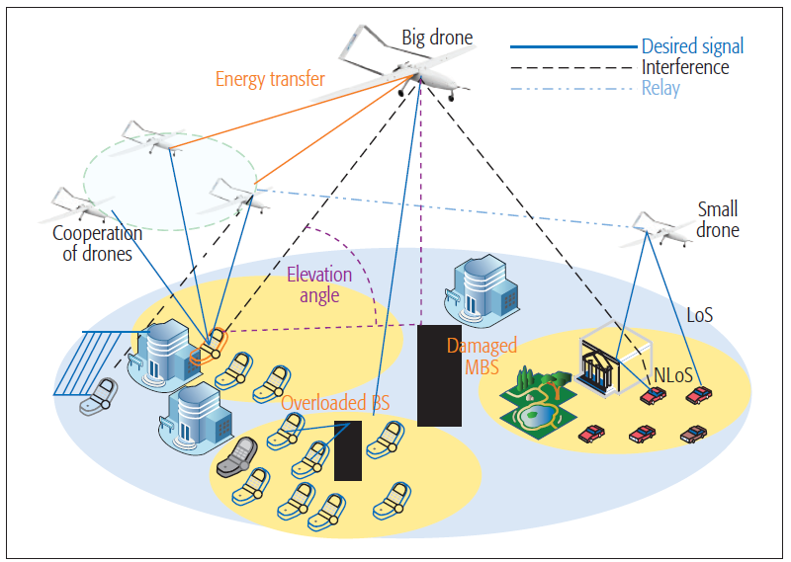
Multi-Tier Drone Architecture for 5G/B5G Cellular Networks[5]
Structures:
High-Altitude Platforms (HAPs) in Stratosphere
Low-Altitude Platforms (LAPs) in Atmosphere
Benefits:
Better Line-of-Sight (Los)
Better Spectral Efficiency (SE)
Adjust Quality of Service by Dynamic Deployment
Avoid Over-Engineering of 5G terrestrial Base Station
HAPs
LAPs

Slide 8
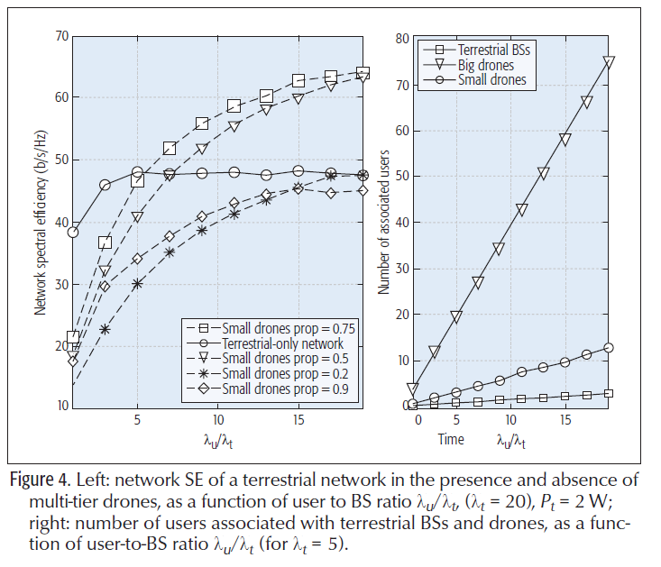
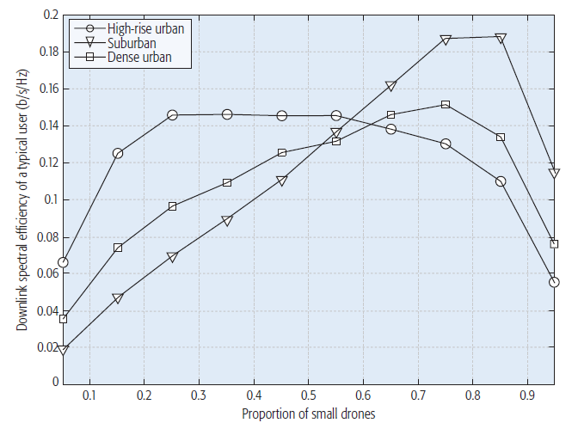
Multi-Tier Drone Architecture for 5G/B5G Cellular Networks[5]
Structures:
High-Altitude Platforms (HAPs) in Stratosphere
Low-Altitude Platforms (LAPs) in Atmosphere
Benefits:
Better Line-of-Sight (Los)
Better Spectral Efficiency (SE)
Adjust Quality of Service by Dynamic Deployment
Avoid Over-Engineering of 5G terrestrial Base Station
SE (b/s/Hz)
Downlink SE per User (b/s/Hz)
Proportion of Small Drone
User-to-Base Station Ratio

Slide 9
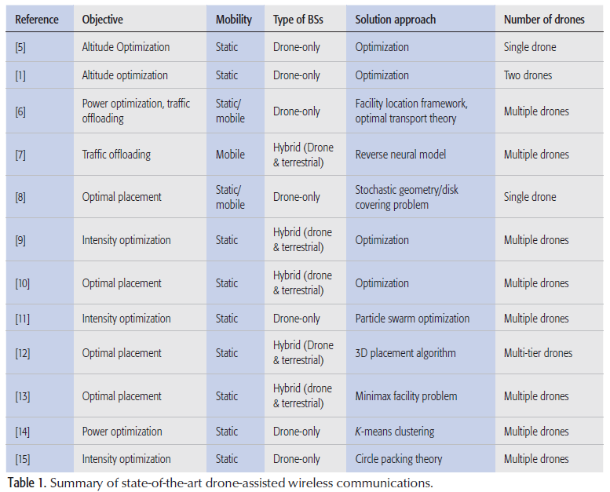


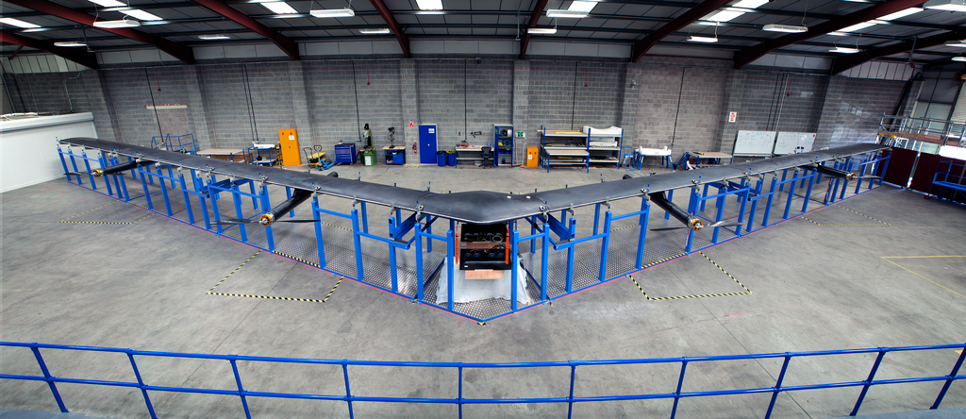

Current Work [5]
SKYBENDER
Aquila

Slide 10
Pros and Cons of LAPs [5] (Compared with HAPs)
Pros:
High Mobilities
Short Line-of-Sights
Cost-Efficient
Cons:
Only Lift Limited Weight (<7kg)
Limited Duration (<1hr)
Spatial-Reconfigurable Phased Array (SPRArray)
High Gain Saves Power
Operate While Charging

Slide 11
Outline
Introduction to Spatial-Reconfigurable Phased Array (SPRArray)
Application & Motivation
Multi-Tier Drone Architecture for 5G/B5G Cellular Networks: Challenges, Trends, and Prospects [5]
Survey on Previous Work
Radiation analysis of conformal phased array antennas on distorted structures (2003) [1]
A Self-Adapting Flexible (SELFLEX) Antenna Array for Changing Conformal Surface Applications (2013) [2]
A Survey on Indoor Positioning Systems (2014) [3]
Survey of Indoor Localization Systems and Technologies (2019) [4]
Self-Invented Microwave Assisted Positioning
Setup & Data Interpretation
Range Resolution: 2.3cm ; Max. Detection Range: 1.5m

Slide 12
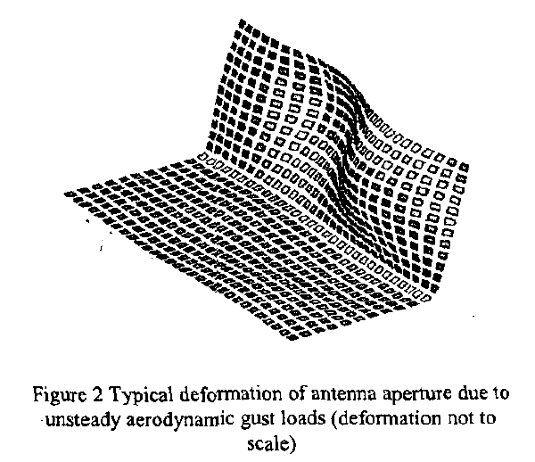
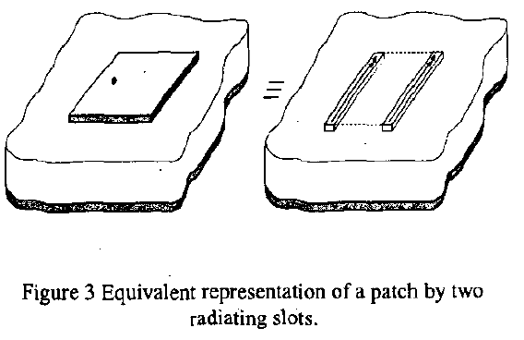
Radiation analysis of conformal phased array antennas on distorted structures [1]

Slide 13
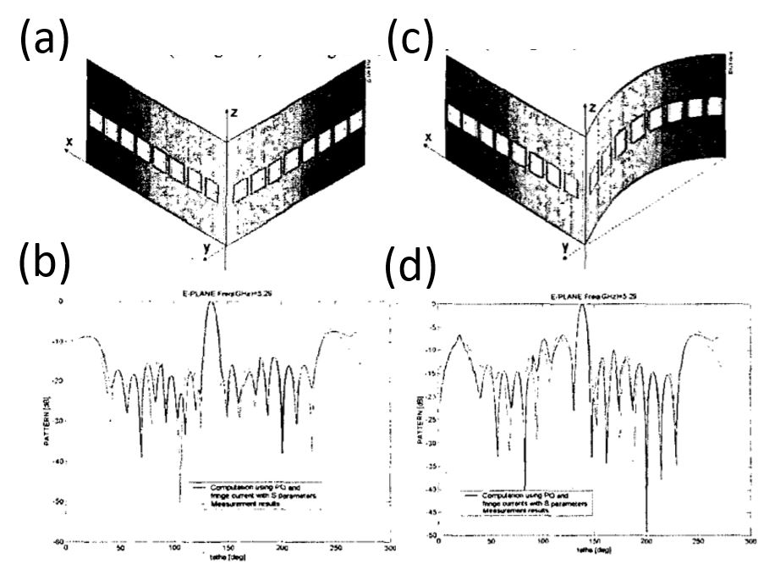
Radiation analysis of conformal phased array antennas on distorted structures [1]

Slide 14
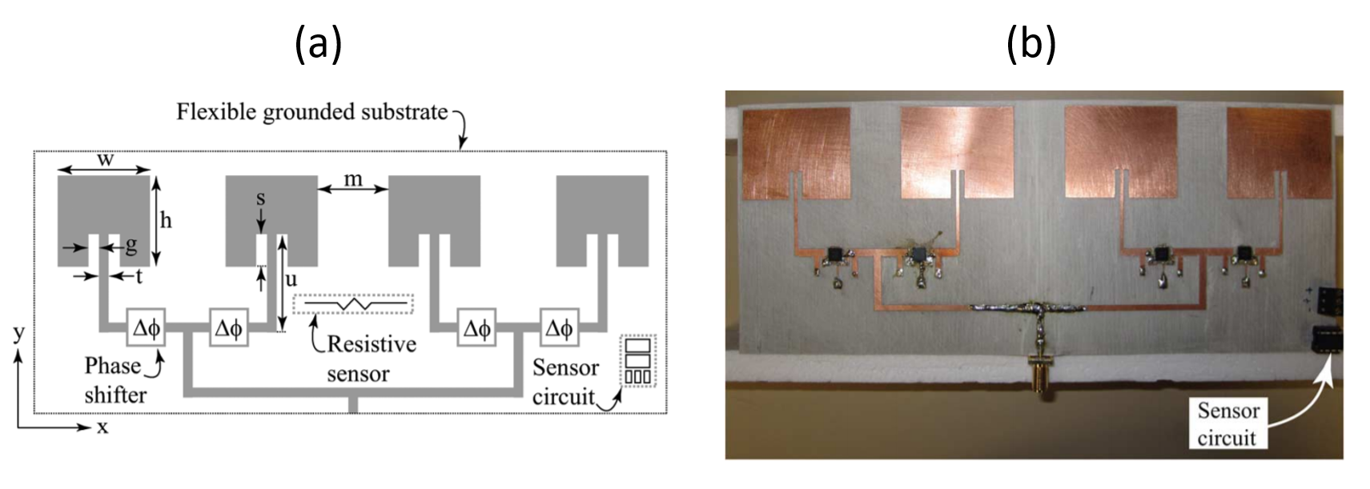
A Self-Adapting Flexible (SELFLEX) Antenna Array for Changing Conformal Surface Applications (2013) [2]

Slide 15
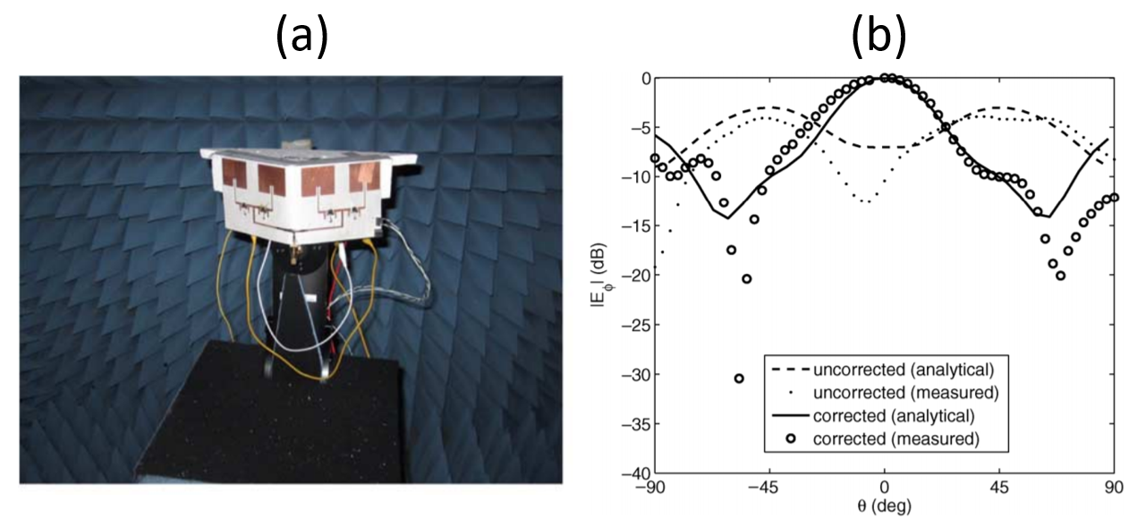
A Self-Adapting Flexible (SELFLEX) Antenna Array for Changing Conformal Surface Applications (2013) [2]

Slide 16
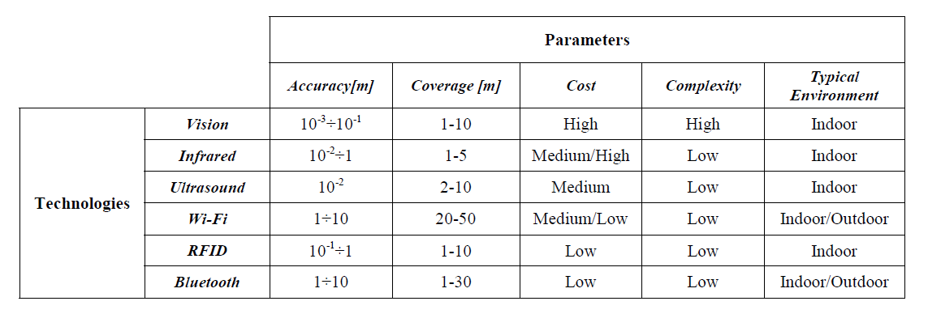
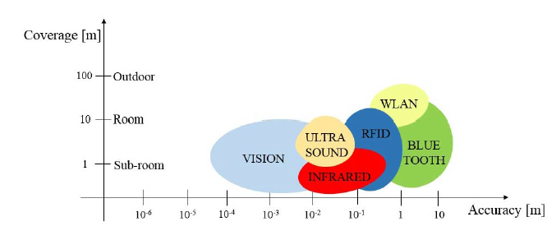

A Survey on Indoor Positioning Systems (2014)[3]
Solutions | Precision | Response | LoS | BW
Vision | 0.001m | Long | Yes | n/a
Infrared | 0.01m | Short | Yes | n/a
Ultrasound | 0.01m | Short | n/a
Wi-Fi | 1m | RSSI (1 sec.) | No
Bluteooth | 1m | RSSI (1 sec.) | No
RFID | 0.1m | Short | No
UWB |  |  | No | Wide
Proposed System | 0.005m | 0.1 sec | No | Narrow
$$0.1λ of 6GHz$$

Slide 17
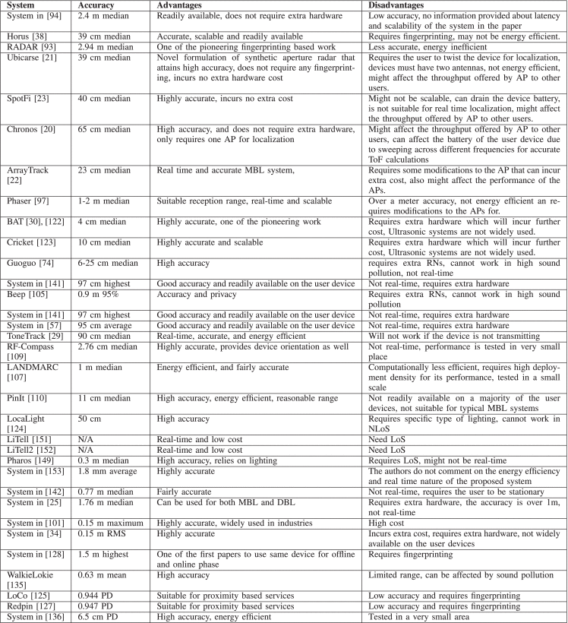
Survey of Indoor Localization Systems and Technologies (2019) [4]
Wi-Fi
UltraSonic
Solutions | Precision | Response | LoS | BW
Vision | 0.001m | Long | Yes | n/a
Infrared | 0.01m | Short | Yes | n/a
Ultrasound | 0.01m | Short | n/a
Wi-Fi | 1m | RSSI (1 sec.) | No
Bluteooth | 1m | RSSI (1 sec.) | No
RFID | 0.1m | Short | No
UWB |  |  | No | Wide
Proposed System | 0.005m | 0.1 sec | No | Narrow
BT
RFID
$$0.1λ of 6GHz$$

Slide 18
Outline
Introduction to Spatial-Reconfigurable Phased Array (SPRArray)
Application & Motivation
Multi-Tier Drone Architecture for 5G/B5G Cellular Networks: Challenges, Trends, and Prospects [5]
Survey on Previous Work
Radiation analysis of conformal phased array antennas on distorted structures (2003) [1]
A Self-Adapting Flexible (SELFLEX) Antenna Array for Changing Conformal Surface Applications (2013) [2]
A Survey on Indoor Positioning Systems (2014) [3]
Survey of Indoor Localization Systems and Technologies (2019) [4]
Self-Invented Microwave Assisted Positioning
Setup & Data Interpretation
Range Resolution: 2.3cm ; Max. Detection Range: 1.5m

Slide 19
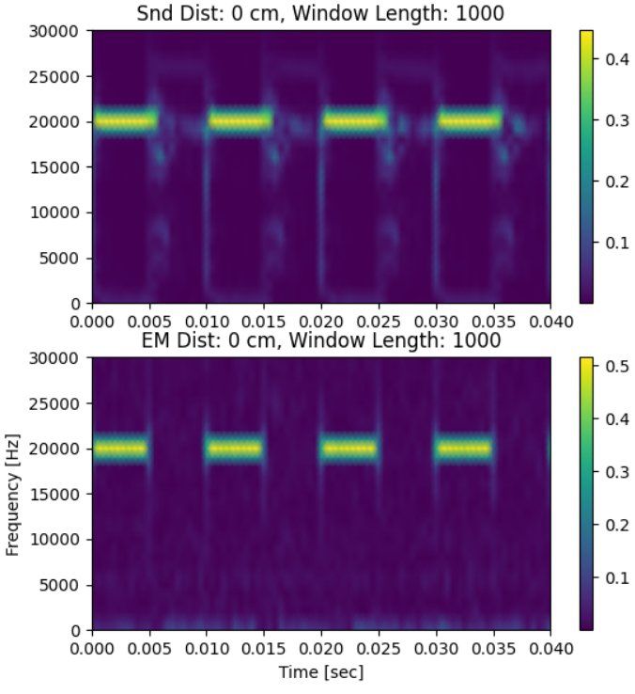
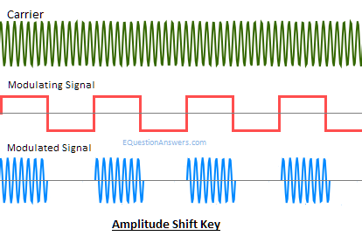
Self-Invented Microwave-Assisted Positioning (MAP)
2.9GHz
Sine
RF SG
OSC
20 kHz
ASK
IF SG

Slide 20
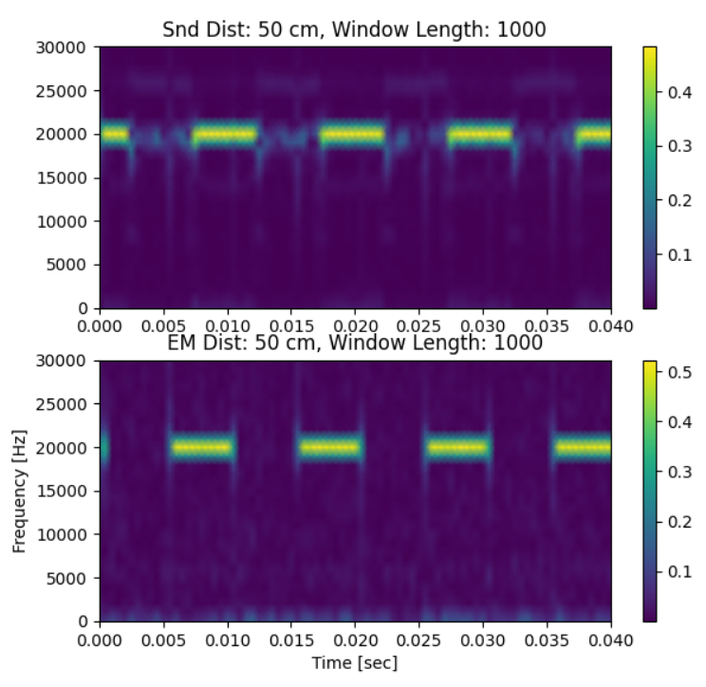
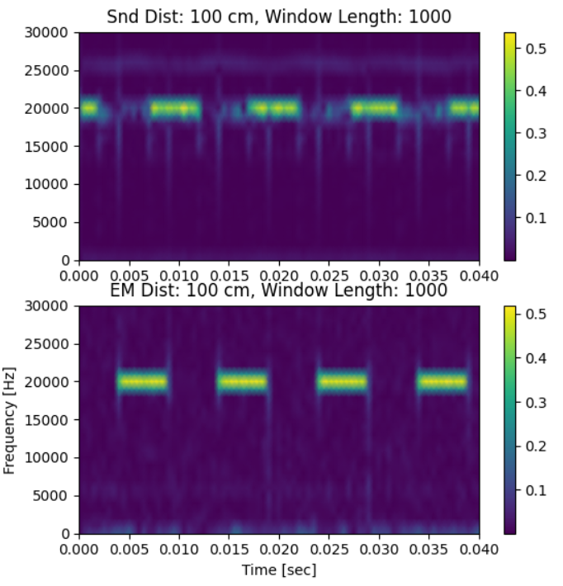
Setup of Distance Measurement

Slide 21
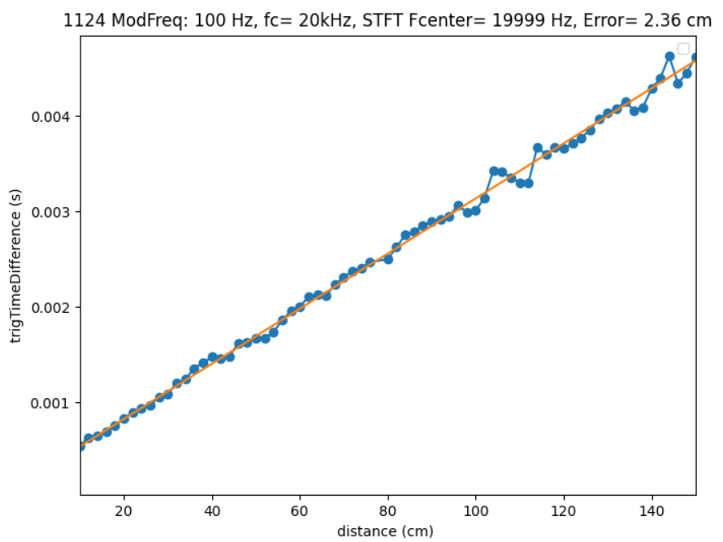
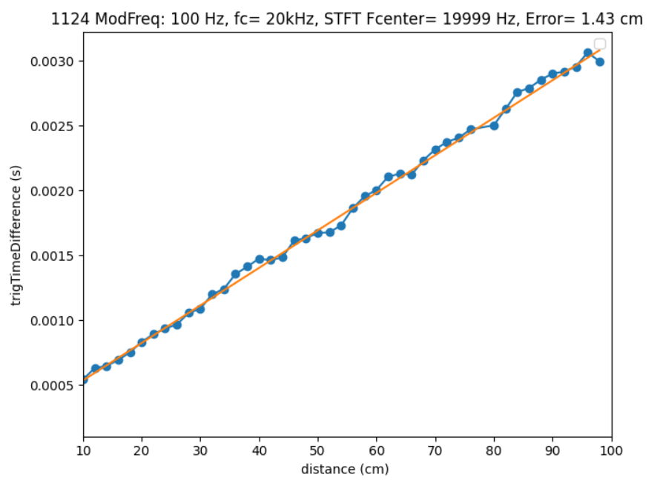
Measured Results
RMS Error = 2.36cm
RMS Error = 1.43 cm

Slide 22
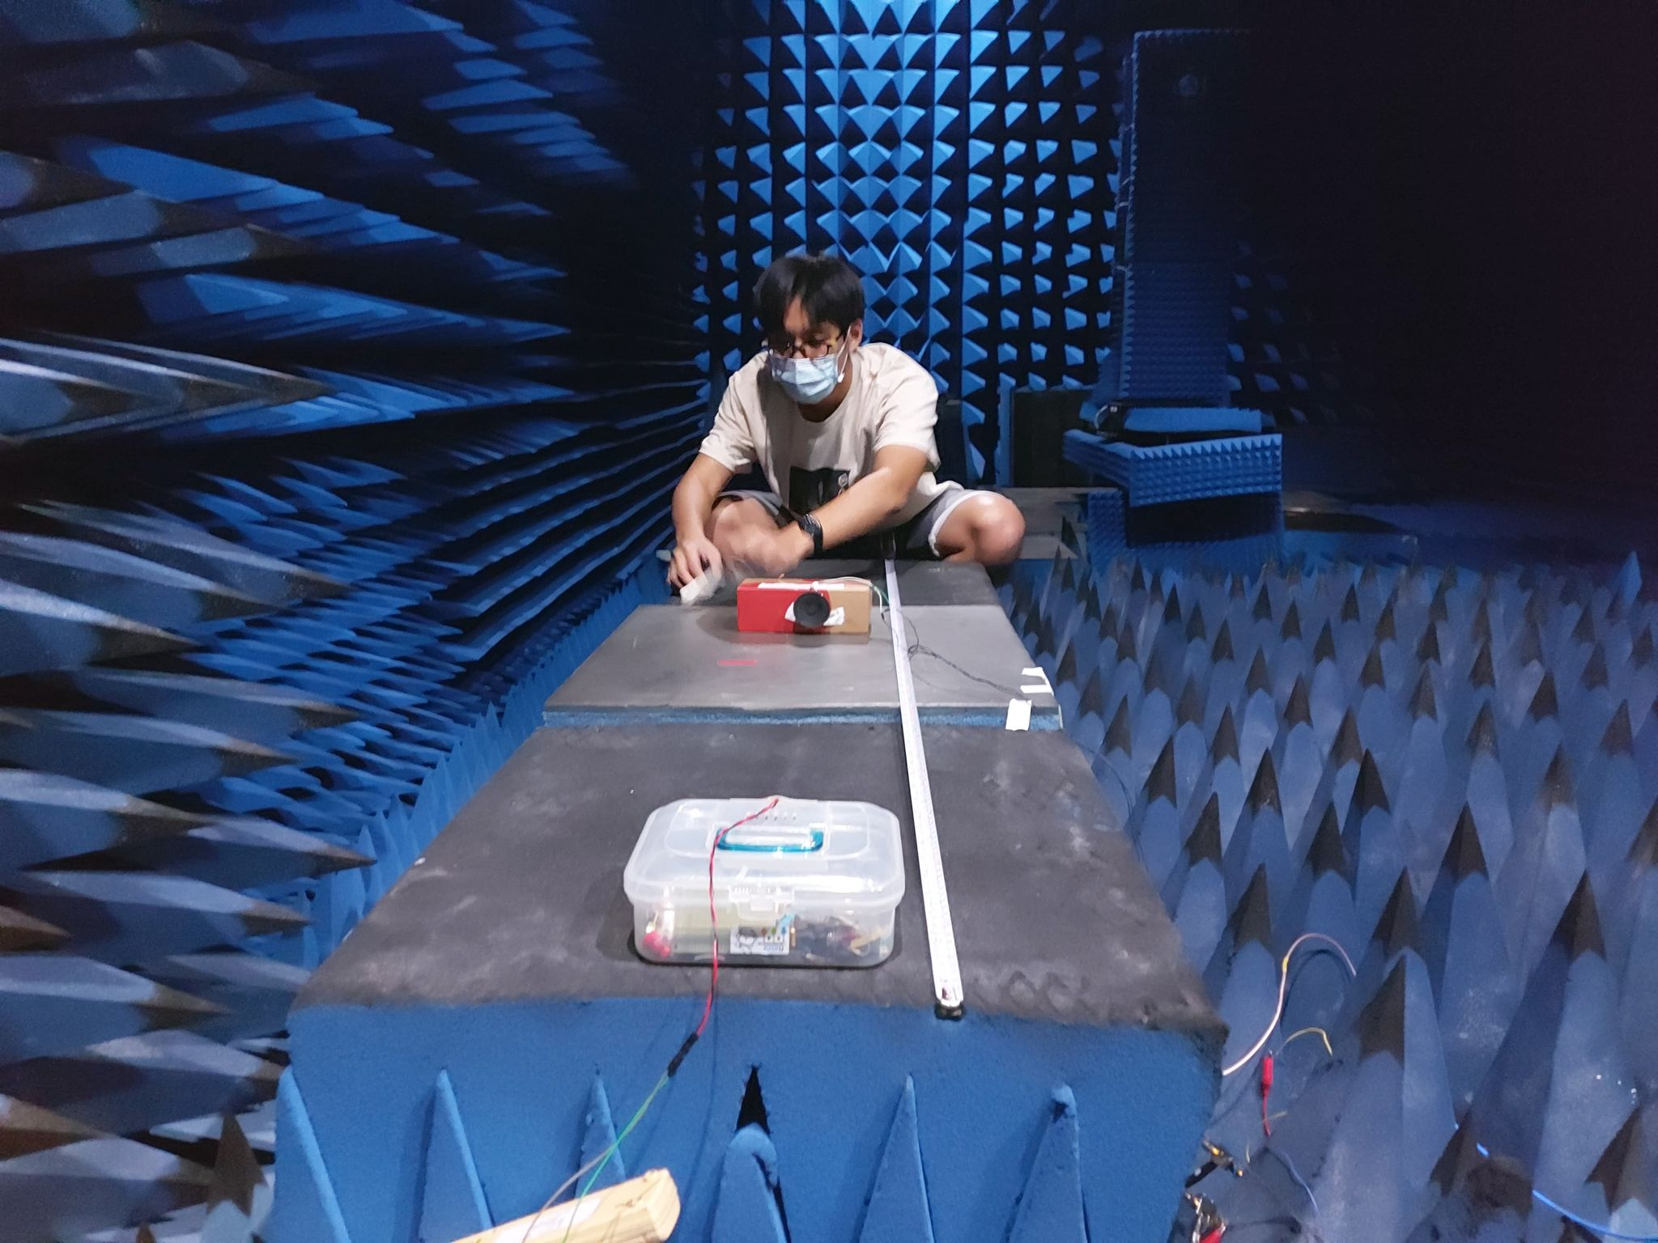
Conclusions
SRPArray has the potential to be applied to 5G/B5G network
SELFLEX has proved the concept of SRPArray is functionable
MAP has reached range resolution: 2.3cm within 150 cm

Slide 23
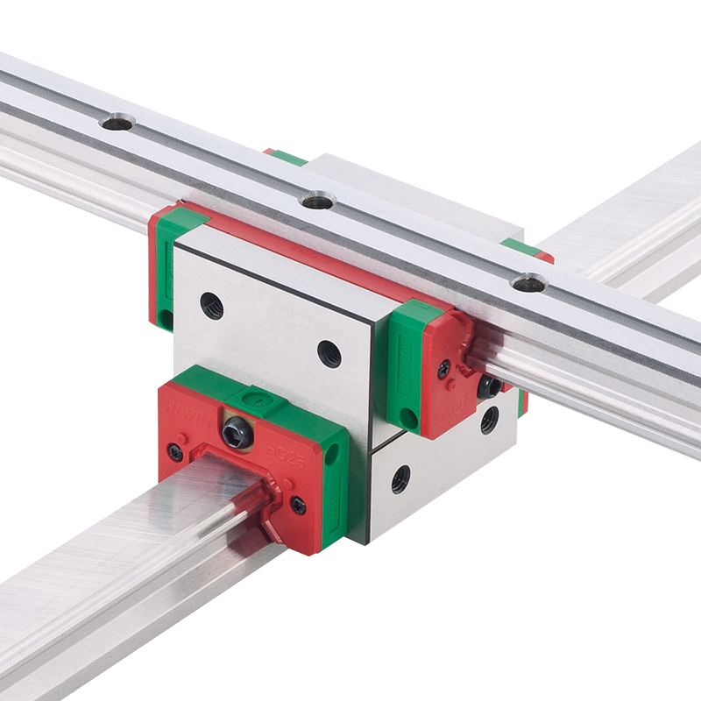
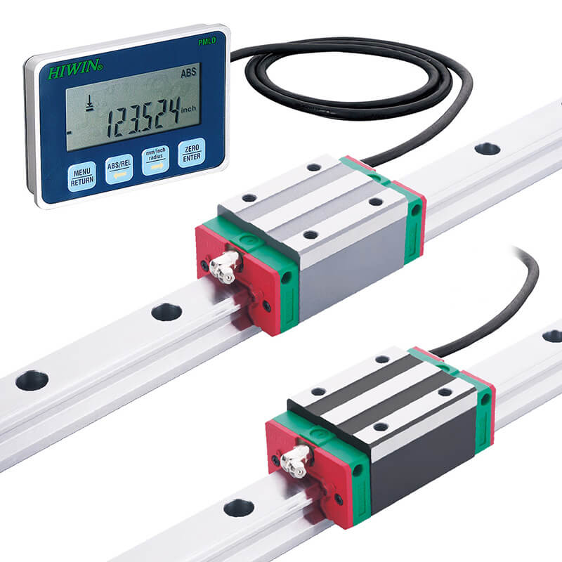


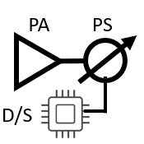
Future Work
Use Slide Rail to Improve the Accuracy of Measurement
Measure Positioning on 2D Plane
Encode the Signal Processing Code to Embedded System
Measure Phase Compensation Abilities of SPRCube
S21 Meas.
Master
Slide Rail
Slave

Slide 24
Reference
[1] H. Schippers, G. Spalluto, and G. Vos, “Radiation analysis of conformal phased array antennas on distorted structures,” in Twelfth International Conference on Antennas and Propagation, 2003 (ICAP 2003). (Conf. Publ. No. 491), Mar. 2003, vol. 1, pp. 160–163 vol.1, doi: 10.1049/cp:20030040.
[2] B. D. Braaten et al., “A Self-Adapting Flexible (SELFLEX) Antenna Array for Changing Conformal Surface Applications,” IEEE Trans. Antennas Propag., vol. 61, no. 2, pp. 655–665, Feb. 2013, doi: 10.1109/TAP.2012.2226227.
[3] L. Mainetti, L. Patrono, and I. Sergi, “A survey on indoor positioning systems,” in 2014 22nd International Conference on Software, Telecommunications and Computer Networks (SoftCOM), Sep. 2014, pp. 111–120, doi: 10.1109/SOFTCOM.2014.7039067.
[4] F. Zafari, A. Gkelias, and K. K. Leung, “A Survey of Indoor Localization Systems and Technologies,” IEEE Commun. Surv. Tutor., vol. 21, no. 3, pp. 2568–2599, thirdquarter 2019, doi: 10.1109/COMST.2019.2911558.
[5] S. Sekander, H. Tabassum, and E. Hossain, “Multi-Tier Drone Architecture for 5G/B5G Cellular Networks: Challenges, Trends, and Prospects,” IEEE Commun. Mag., vol. 56, no. 3, pp.

